Slide 1
This was written with the assumption that workbooks would be added.
Even if these are not introduced until later, the same basic ideas apply
Hopefully upload can be broken into component steps
In text-assays, ideally we could define which steps to include and/or replace a step with custom HTML

Slide 2
Generalized steps of upload:
Create experiment, set run type(s), define batch, run-level attributes (like description).
Import sample sheet, which defines sample attributes. At time of import, checks are performed on sample info to improve accuracy, consistency
Depending on instrument: user exports file to be imported into instrument’s software (based on run/sample info). Instrument type also determines what file format labkey expects when the results are imported. Discussed more later.
Select ‘instrument type’. Initially, the only available instrument will be ‘Generic CSV file’.
Import results. Like sample import, checks are performed at time of import to improve accuracy
Formal ‘approval’ step. This is when a user releases data for reporting or marks it failed. Failed samples can be requeued into a new run of this batch.
Users should be able to stop after completing any of these steps and resume at a later time

Slide 3
Batch/Run/Sample
Having the distinction of batch, run and sample is important
There are certain fields most appropriate for each level and each unit is important
The problem is that even single samples or single runs should probably get these batch/run attributes (ie. a batch of 1 sample)
During the import process, the user shouldn’t really need to know that batches and runs are being created

Slide 4
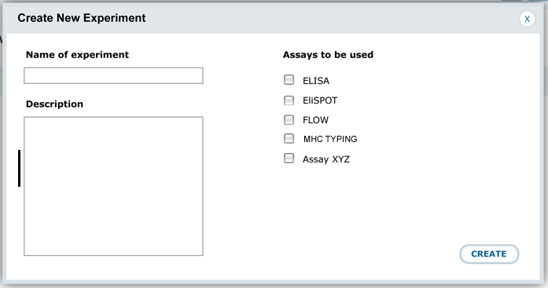
Step 1: create experiment, define assay type(s)
This is a very simple start page
I actually found it difficult to create a run with the existing experiment/assay interface
This assumes workbooks are added. If not, you would probably only get to pick one assay type
This is kind of like creating a run group (even if you have 1 run)
I’d suggest that this replace some of how ‘batch’ is used. I understand why batch exists, but think its purposes should to be separated (next slide).

Slide 5
Step 2: Enter Number of Plates
The purpose of having ‘batch’ seems to be to give a grouping of multiple runs.
I’d much rather see the second step of this process being a simple ‘enter plate number’ field (meaning this unit will have X runs).
This way users make a batch without really needing to know it exists
Even a run of one plate should get batch attributes
Perhaps this is defined in step 1

Slide 6
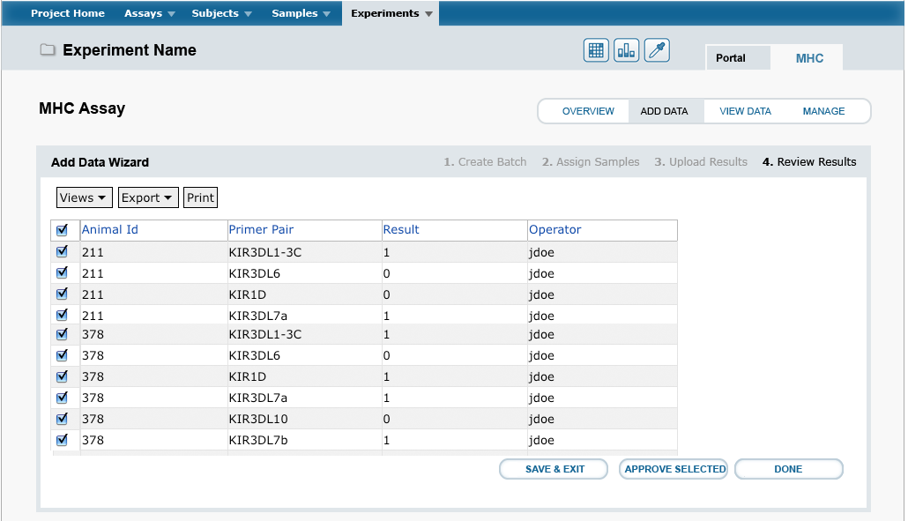
Step 3: upload sample info
Users upload sample info from a CSV file
We separate sample and result import so that runs can be created prospectively
This is useful for organization/productivity management. Discussed later.
For plate based assays, it might be useful if labkey formally supported a ‘sample type’ field, which is a flag for negative control, positive control or experimental sample
Maybe a formal category not needed

Slide 7
Step 4: Choose ‘Instrument’
I’d suggest that each assay support multiple ‘instruments’ for import. Each instrument specifies the format of the data that will be imported
Each assay should include ‘CSV’ as an import type – this would be a basic CSV format and would use the default upload behavior
Many instruments generate some sort of text output that doesn’t match the standard CSV format
Specifying ‘instrument X’ defines the parsing script that will convert the output of the instrument into the format stored in labkey (these would be a custom script in the assay folder by/for the user)
This way we do not need separate assays for ELISPOT using a Beckman Reader and ELISPOT using a Biomek – the data from each ends up in the same assay
If a new client has another instrument, you only need to add one import parsing script (ideally defined in the text-assay folder) rather than make them a new assay
Select Data Source:
CSV File
Biotek 550 ELISA Reader
Beckman 382 ELISA Reader

Slide 8
Step 5: Download Sample Info
This will not always be needed
Some instruments accept an import text file to define sample info within their software
It would be a big time and accuracy improvement if we could export the sample info we already uploaded in labkey then import it direct into the instrument software (rather than type it twice)
This would become an option if the user creates a custom export script in the text-assay folder

Slide 9
Step 6: Upload Results
Depending on the instrument selected in step 5, a distinct script will be used to parse the incoming results (again, if the user wants to make a new instrument, they put this script in some location in the assay-folder)
The default instrument ‘CSV’ can use the default code
In the case of CSV import, it would be really useful if when the user downloads the excel file for results upload, it was pre-filled out with the sample name, etc. This way the user only needs to enter the results columns and sampleID will always match. Maybe each row of this excel file has a ‘sampleID’, which is used to connect result record with sample record.

Slide 10
Step 7: Approval
As an optional final step, new samples might need to be ‘approved’ by some user who has appropriate permissions, after which they become available to the rest of the group
If samples are not approved, we do not want them appearing to queries based on that assay
Users can also mark samples as ‘failed’ (meaning they are not available for queries)
Failed samples can be requeued into a new run

Slide 11
Other Ideas:

Slide 12
Status Fields
The ability to create runs prospectively has a lot of benefits
Runs should contain some sort of status field to show which step in the process they are in
It’s a great productivity and sample management tool
Users can create experiments, enter sample info, etc. A supervisor or lab manager might create the runs, then assign them to techs.
Having these runs in the system helps keep track of what benchwork they need to do
If this is being used by a core facility, as users request services, they could either be automatically created as a run, or added by some member of the core.
The status also helps alert the user what stuff still needs to be imported
Helps them keep up with ‘bookkeeping’ that they might otherwise ignore
Should also have the ability to ‘abort’ or ‘fail’ a run, meaning we decided not to do it or it just didn’t work
Other powerpoint on Assay UI has more on this

Slide 13
Combine Sample/Results Upload
The steps I outline guide the user through a multi-step upload
There are cases where a user will want a simple, fast way to import
For each assay, there should be an ‘add single sample’ button, which gives the user a web-form with batch, run and sample fields. In this case, they enter one sample, and also create a batch and run without knowing it.
Perhaps there could be a toggle during the sample upload step, where users can pick ‘I want to upload both samples and results’. If this is selected, they download one excel sheet, enter both, then import. If not, they get a different excel sheet with columns for sample information only.

Slide 14
The ‘General’ Assay:
The simplest assay will allow user to import sample information, then simply mark when each sample is ‘complete’ (no results imported)
It might not even have samples, just a description
The purpose of creating an experiment without samples or an assay type would be to mark that something happened or needs to happen
Just because there are steps in that assay, we might not care about tracking them in the system. Sometimes tracking benchwork would be more hassle than it is worth. If a step does not produce something that needs to be imported, there may not be a whole lot of benefit to tracking it.
When workbooks are supported, they will allow the user to attach files to this run. This provides a flexible way to store virtually anything, including data not otherwise amenable to becoming an assay
Most assays actually have multiple steps required prior to the step that actually generates the data – these steps would be defined as one of these general assays

Slide 15
Adding custom steps?
There might be cases when adding some custom step between others could be useful. For example:
An assay has two steps in which results are collected. I might want to import the values from the first step before the results of the second step.
I might want to add a step that doesn’t actually do anything except change the status. For example, say my assay involves moving samples through three steps of benchwork. I might want to select all samples in a run, then mark that this step occurred. Perhaps the system would allow these to be inserted as custom HTML

