Slide 1
Interacting with Assay Data

Slide 2
Basic Ways to Interact:
Experiment: cuts across all assay types
Assay: by batch, run or sample

Slide 3
Assay View:
Most of this already exists in labkey
Should give user a grid of data from one assay by either batch, run or sample (like grid here: /assay/home/assayRuns.view)
I believe much of this already is possible in text-assays, but we should be able to define the default view for each grid (batch/run/sample) as text. This way it gets packaged when the assay is distributed
The fields of these grids might not actually be the same as the underlying table. It would be useful to be able to write a query and use it to replace the table (also defined as a text-file)
Each view might have an ‘add sample button’, much like regular lists. This produces a form with batch/run/results fields. It creates a single-sample run without user knowing it

Slide 4
Assay View:
Users should be able to create different ‘actions’ associated with either the batch/run/result views of an assay
Each action is an HTML page that does something to or with the selected results
Gives a really flexible way to interact with assay data without needing to constantly write custom HTML for the basic view
Could be written as HTML, placed somewhere is simple modules folder
Saves a whole lot of cases where users would otherwise need to maintain custom batches.html, runs.html and results.html pages.
When multiple actions exist, the menu is cleaner than creating a button for each.
My example puts the menu below, but maybe it should be in the button bar
Some actions are generic across all assays, like export, remove, etc. Custom example include
Export as something other than CSV (like FASTA)
Set the value of some field across lots of records
Produce some sort of custom visualization

Slide 5
Experiment View:
Experiment: cuts across all assay types
Assay: by batch, run or sample

Slide 6
Experiment View:
Experiment is kind of like a run group
User can see all experiments in the system or filter what they created
The view contains expts from all assay types (not just one assay)
Experiment will have a ‘status’
Could be filtered by default to show only expts that are not ‘complete’
This is a good productivity tool (users can easily see what work they have to do) plus it gently forces users to completely fill out information (runs don’t become complete until all steps are finished)
If this could be combined with the ability to assign runs to technicians, assign a due date and prospectively create runs, it becomes really useful
When you click an expt, you open it’s workbook, which has a tab for each assay type within it
Granted workbooks might not be introduced until later
Should allow searching from this view
Should be able to search against all sample or run attributes within expts and return a list of expts containing matches (ie. ‘any field or text contains ZZZZZ’)
For common fields like subjectID, we might want to allow filtering specifically on that field (subjectID=X)
Note that each expt is assigned a numeric ID
In this view perhaps each expt could be expanded to show one row for runs it contains? (next slide)
ID | Description | Assay Type | Owner | Status
100 | MHC Typing of Animal Y | SSP | bbimber | Active
101 | Another Expt | Multiple | bbimber | Active
102 | One more | ELISPOT | bbimber | Complete
103 | Another one | General | bbimber | Complete

Slide 7
Expanding expt to show runs:
This way you can see status of each individual run or download the run. However, you still retain each expt as one unit.
Each run has its own ID
Perhaps that ID is related to expt id, perhaps not
ID | Description | Run ID | Assay Type | Owner | Status
100 | MHC Typing of Animal Y |  | SSP | bbimber | Active
101 | Another Expt
 |  | 101-1 | SSP | bbimber | Samples Added
 |  | 101-2 | ELISPOT | bbimber | Failed
 |  | 101-3 | ELISPOT | bbimber | Pending
 |  | 101-4 | ELISA | bbimber | Complete
102 | One more |  | ELISPOT | bbimber | Complete
103 | Another one |  | General | bbimber | Complete

Slide 8
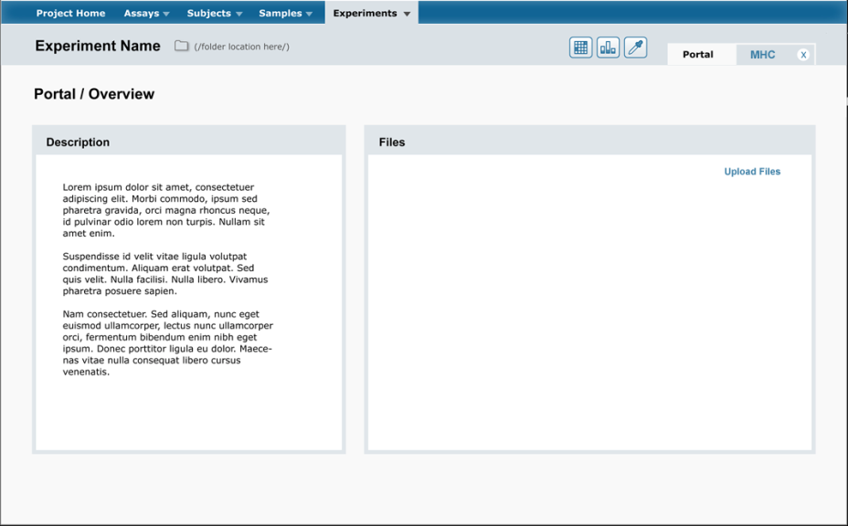
The expt workbook
Clicking an expt will open the expt workbook
This might not happen immediately, but it will be really useful when it does
It’s like a run group, but better
Workbook is useful as a container of related information
Should be able to add multiple assays tabs.
Retaining order might be useful. Often assay 1 leads to assay 2, etc (as opposed to alphabetic order).
Each tab reflects a given set of samples moving through one assay
Each assay tab might have multiple runs
Ie. The user enter 20 samples for an MHC SSP run. Some of these sample might fail in the first run. The user can requeue the failed samples, then make a second run (preferably in the same tab). Process repeats until all samples are complete
Should be able to add any number of blank tabs to write text or attach files
Each workbook should support comments on any tab (like a message board)
Should be able to attach files to any tab (there might be files that pertain to the MHC assay tab, or files that pertain the to ELISPOT assay tab

Slide 9
Overall navigation and aesthetics:
I like the design from the NIH proposal with the top toolbar and high level navigation points
When clicking the assay menu, users get a list of all assays. Clicking one assay takes them to a grid of that assay in which they can toggle between batch/run/result.
It basically takes them direct to the view here:
/assay/home/assayRuns.view

